Slide 1





A Summary of the TribeFlow Model for Music Discovery Applications
Flavio Figueiredo
Notes:
Institutions in order of appearance
Name the authors, where everyone is now

Slide 2
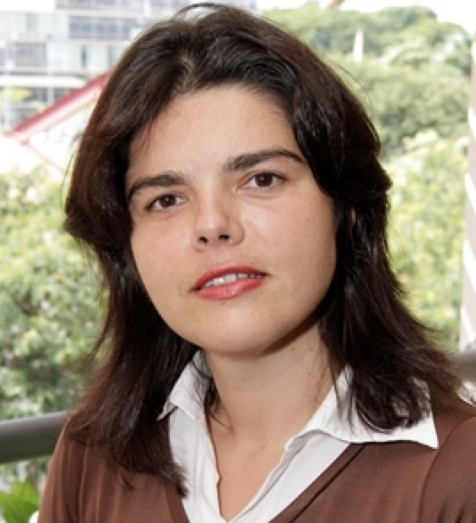

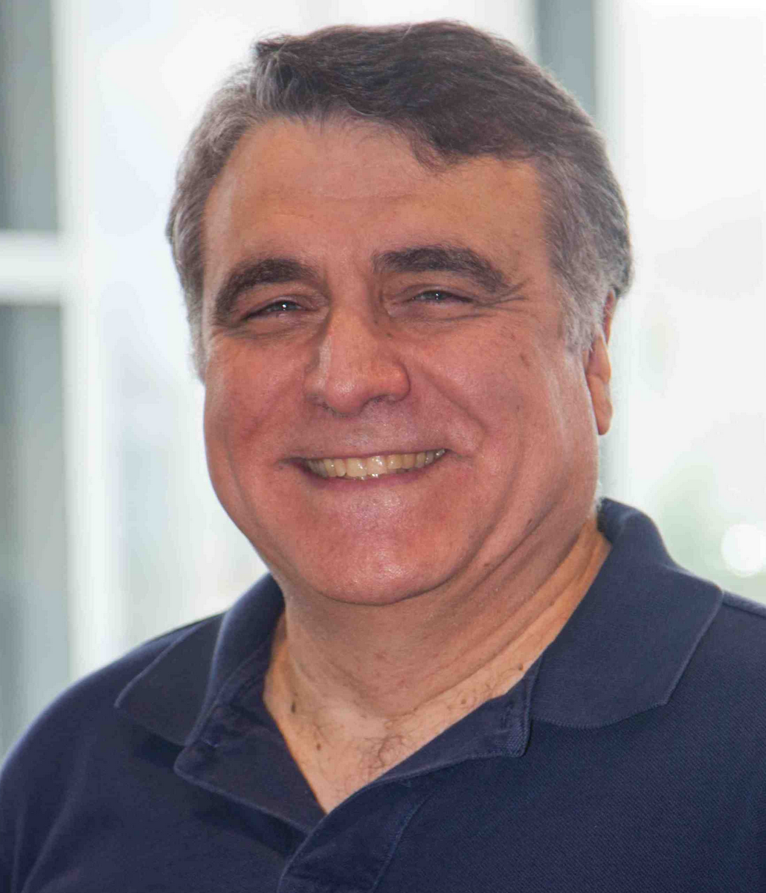
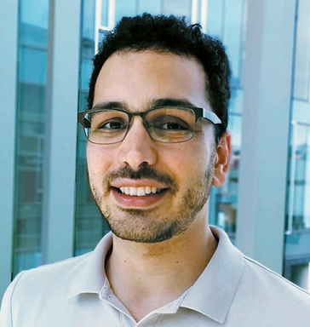
Collaborators
Jussara Almeida Nazareno Andrade Christos Faloutsos Bruno Ribeiro
Notes:
Institutions in order of appearance
Name the authors, where everyone is now

Slide 3


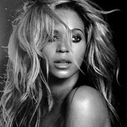



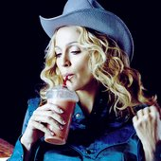

What Happens vs What we See
L1
T₁
L2
Time
T₂
L3
T₃
L1
3
Notes:
- Public datasets: user, item, time. Anonymous

Slide 4


Different Behaviors Different Trajectories
1
2
3
1
4
1
5
6
7
2m
10m
3m
30m
15m
30s
Duration in Listening to Artist
Notes:
Talk about time
Personalized quicker

Slide 5
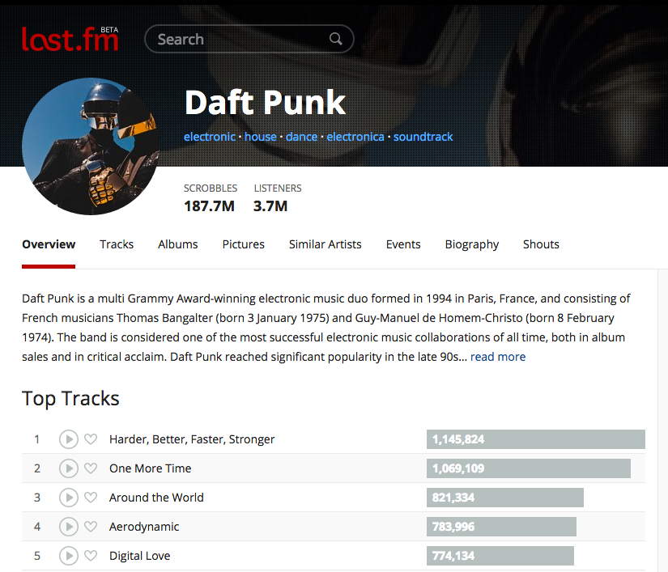
General Motivation
??
Predict where an agent will go next
That is, which artist
will Alice listen to
next?
5
Notes:
Can be used to predict
Music Recommendation
Similar Items Recommendation

Slide 6
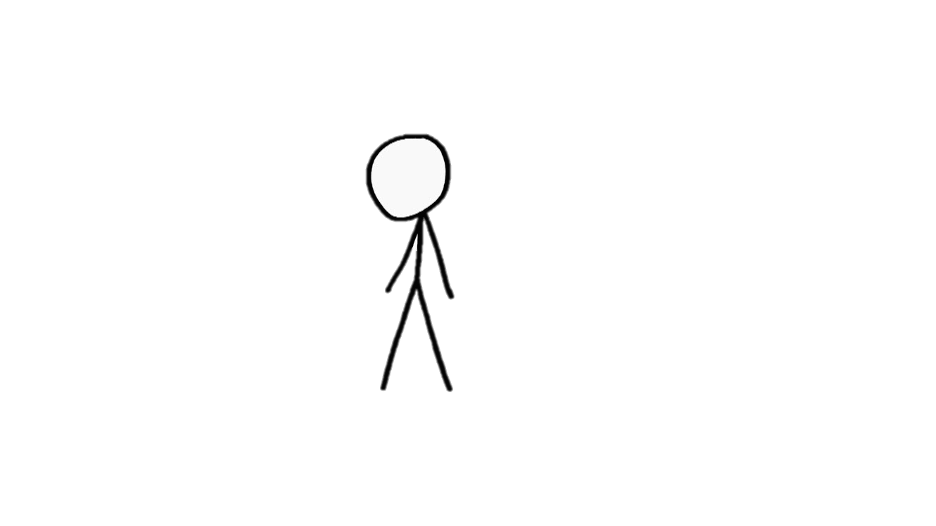
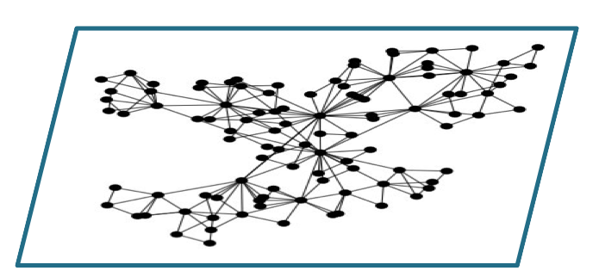

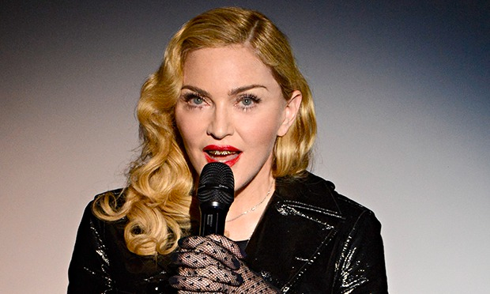

How we Navigate?
Notes:
Inside the website
Talk about constraints here

Slide 7
Simple Navigation Process (e.g., PageRank)
3
2
Visible Links
Random Walks w. Random Jumps to Random Nodes
5
4
1
6

Slide 8
Random Walk Transition Matrix
What if we don’t see the links?
Trajectories are all we see.
 | 1 | 2 | 3 | 4 | 5 | 6
1 | .025 | .025 | .025 | .875 | .025 | .025
2 | .45 | .025 | .025 | .45 | .025 | .025
3 | .025 | .875 | .025 | .025 | .025 | .025
4 | .025 | .025 | .025 | .025 | .45 | .45
5 | .025 | .025 | .875 | .025 | .025 | .025
6 | .166 | .166 | .166 | .166 | .166 | .166
3
2
5
1
2
3
4
1
6
1h
0.5h
And no self-loops: Modeling self-loops is separate problem.
P[Next| Previous]
Notes:
- Markov not markovian

Slide 9
Latent Random Walk Transition Matrices
“Pop Music”
 | 1 | 2 | 3 | 4 | 5 | 6
1 | .025 | .025 | .025 | .875 | .025 | .025
2 | .45 |  | .025 | .45 | .025 | .025
3 | .025 | .875 |  | .025 | .025 | .025
4 | .025 | .025 | .025 |  | .45 | .45
5 | .025 | .025 | .875 | .025 |  | .025
6 | .166 | .166 | .166 | .166 | .166 | .166
Latent Transition Matrices
Navigation constraints
Navigation preferences based on user types
We must learn:
Transition matrices from trajectory data
From multiple users
User preferences over matrices
“Bossa Nova”
 | 1 | 2 | 3 | 4 | 5 | 6
1 | .165 | .165 | .165 | .165 | .165 | .165
2 | .45 |  | .025 | .45 | .50 | .025
3 | .025 | .875 |  | .025 | .025 | .025
4 | .025 | .025 | .025 |  | .45 | .45
5 | .025 | .025 | .875 | .025 | . | .025
6 | .166 | .166 | .166 | .166 | .166
“Heavy Metal”
 | 1 | 2 | 3 | 4 | 5 | 6
1 | .165 | .165 | .165 | .165 | .165 | .165
2 | .165 |  | .165 | .165 | .165 | .165
3 | .165 | .165 |  | .165 | .165 | .165
4 | .025 | .025 | .025 |  | .45 | .45
5 | .025 | .025 | .025 | .475 |  | .45
6 | .025 | .025 | .025 | .475 | .45
Notes:
Evitar a palavra fallacy (in reality)
Preference for multiple users

Slide 10
TribeFlow’s Environments
Time between transitions
P[Env = Green | User = Jane]
 | 1 | 2 | 3 | 4 | 5 | 6
1 |  | .165 | .165 | .165 | .165 | .165
2 | .165 | .025 | .025 | .45 | .025 | .025
3 | .165 | .875 | .025 | .025 | .025 | .025
4 | .025 | .025 | .025 | .025 | .45 | .45
5 | .025 | .025 | .875 | .025 | .025 | .025
6 | .166 | .166 | .166 | .166 | .166 | .166
Time between transitions
 | 1 | 2 | 3 | 4 | 5 | 6
1 | . | .165 | .165 | .165 | .165 | .165
2 | .45 | .025 | .025 | .45 | .50 | .025
3 | .025 | .875 | .025 | .025 | .025 | .025
4 | .025 | .025 | .025 | .025 | .45 | .45
5 | .025 | .025 | .875 | .025 | .025 | .025
6 | .166 | .166 | .166 | .166 | .166 | .166
 | .45 | .35 | .1 | .1
 | .50 | .025 | .025 | .45
 | 1 | 2 | 3 | 4 | 5 | 6
1 |  | .025 | .025 | .875 | .025 | .025
2 | .45 | .025 | .025 | .45 | .025 | .025
3 | .025 | .875 | .025 | .025 | .025 | .025
4 | .025 | .025 | .025 | .025 | .45 | .45
5 | .025 | .025 | .875 | .025 | .025 | .025
6 | .166 | .166 | .166 | .166 | .166 | .166
 | 1 | 2 | 3 | 4 | 5 | 6
1 |  | .35 | .165 | .165 | .165 | .165
2 | .165 |  | .165 | .165 | .165 | .165
3 | .165 | .35 |  | ..165 | .165 | .165
4 | .025 | .025 | .025 |  | .45 | .45
5 | .025 | .025 | .025 | .025 |  | .45
6 | .025 | .025 | .025 | .025 | .45 | .45
Time between transitions
Transition & Time
P[Node = 3 | Node = 5, Env = Green] x P[inter-event time > T | Env = Green]
Time between transitions

Slide 11
Problem Definition
5
6
1
Input:
Large dataset of user trajectories from thousands of users
Output:
Set of latent transition matrices
Set of user preferences over these matrices
That is:
Interpretable and accurate Alice will listen to ‘4’ next!
1
4
1
1
2
3

Slide 12
Defining the Model

Slide 13
How many Transition Matrices?
We Use a Bayesian Nonparametric Model
Learned from the data
Dirichlet process prior over user preference vector (rows)
 |  |  |  | …
 | .45 | .35 | .1 | …
 | .50 | .025 | .025 | ...
 | .3 | .3 | .3 | …
Notes:
- Don’t mention topic models

Slide 14
Decomposing User Trajectories
 | .3 | .4 | .25 | .05
Unlikely in Red Environment (Jump)
1
2
3
6
5
7
10
12
2min
1min
2 min
5min
1min
2min
24 hours
Unlikely in Green Environment (Jump)

Slide 15
Dealing With Sparseness
Sparseness Issue
Millions of items (e.g., web pages / artists)
~10¹² bigrams (Source, Destination) – Last.FM artists
Only ~10⁸ (Source, Destination) pairs largest dataset [LastFM-Groups]
Thus, Random Walk transition probabilities over vertices rather than edges (without self-loops)

Slide 16
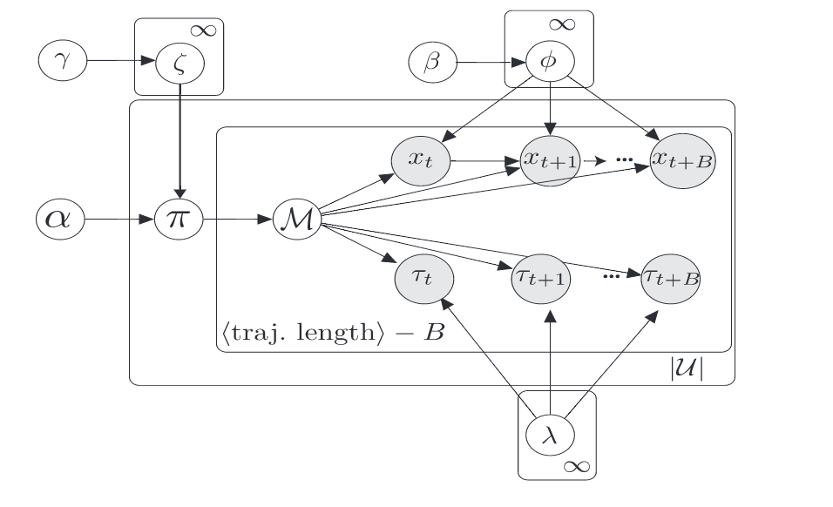
TribeFlow Inference
Gibbs sampling
Item Transitions
User Preferences
Inter-event times
Merge and Split Moves
To infer Dirichlet Process
Fully Distributed
Based on AsyncLDA: Asuncion, 2009, NIPS
Simplify sampling by breaking sequences to size B
B=1 restart after every play (works in practice)

Slide 17
Results

Slide 18
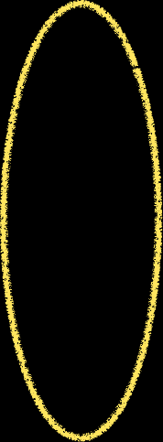
TribeFlow at Work
Years of data
Music Listening Datasets
70% train + validation
30% test
time

Slide 19
Prior Work for Comparison
Latent Markov Embedding (LME), Chen et al., KDD, 2012
Multi-core Latent Markov Embedding, Chen et al., KDD 2013
PRLME, Personalized Ranking LME, Feng et al., IJCAI 2015
Factorizing Machines (FPMC), Rendle et al. WWW 2010
Common issues:
Don’t scale
Not personalized
No probabilistic interpretation
Notes:
- Find a place for this slide

Slide 20
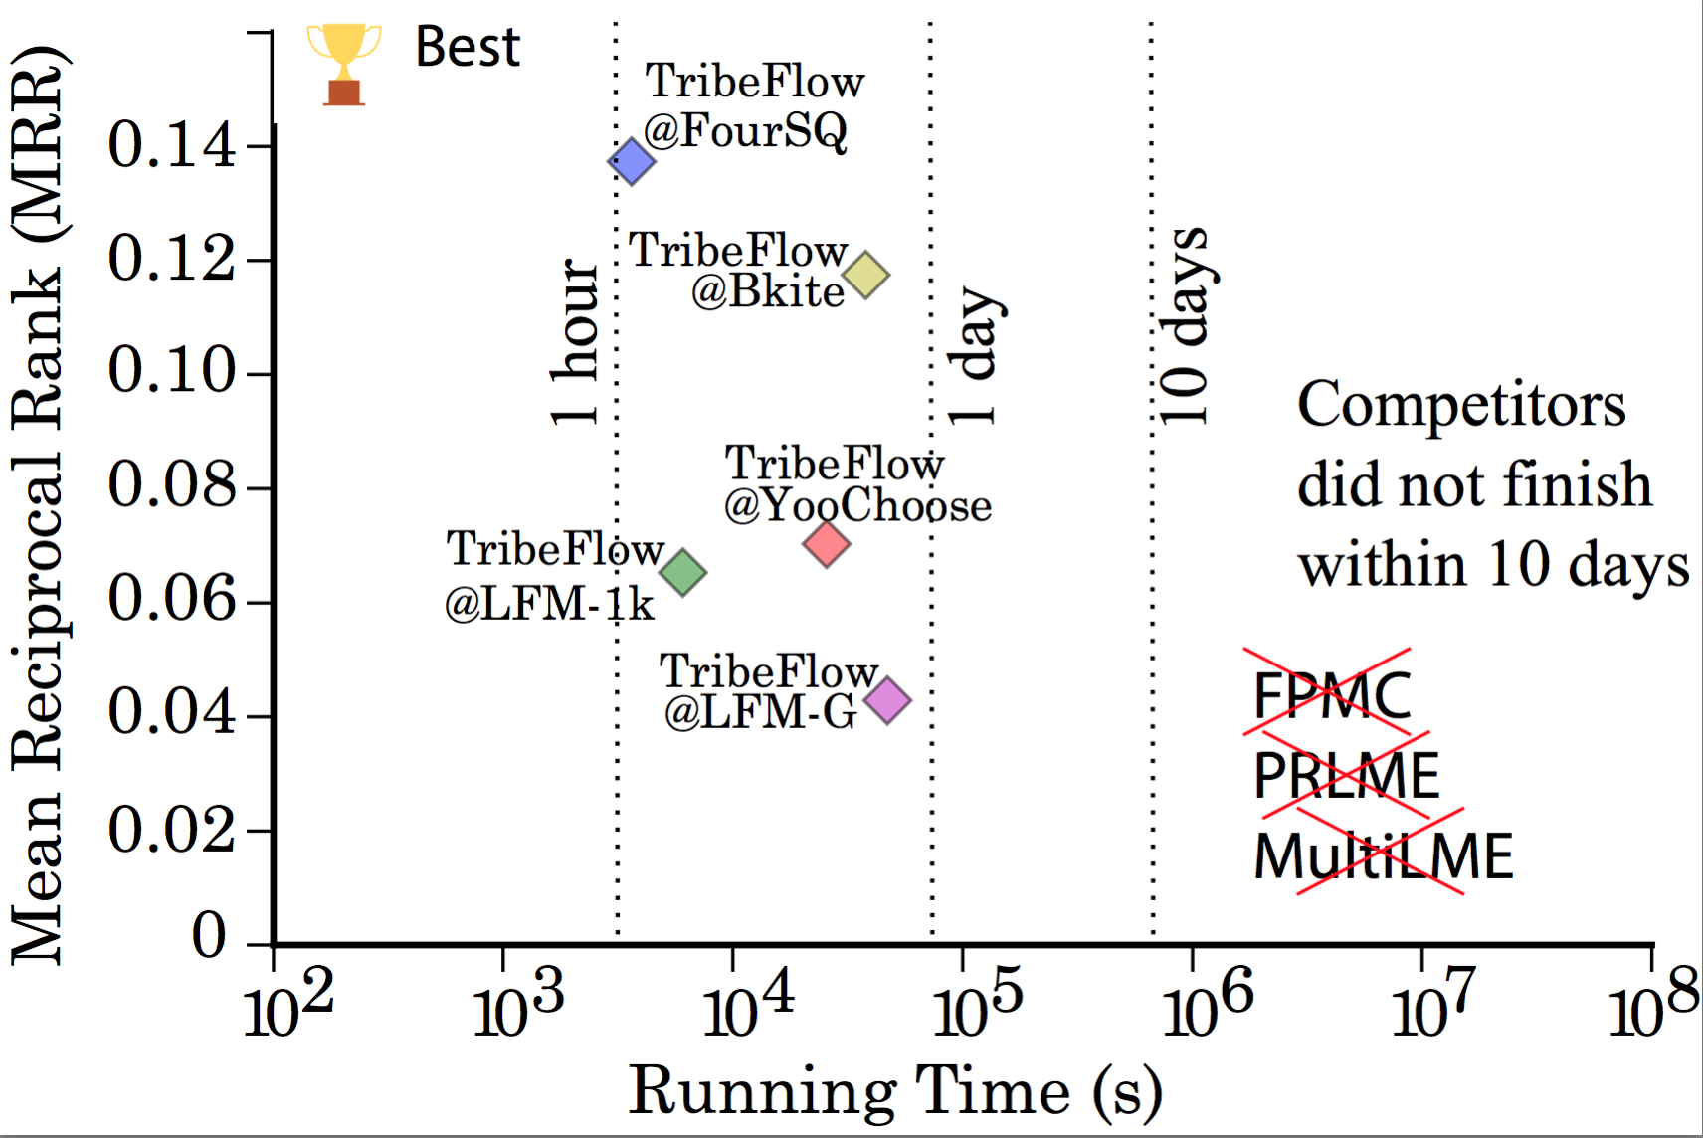
Predicting Where Users Go Next
More Accurate
20 cores
one node
Faster

Slide 21
Focusing on Music Datasets (Subsamples)
Using Subsamples of the Data (10k consecutive transitions)
Similar results for other subsamples
 | LastFM-1k | LastFM-Groups
FPMC | 0.00043 | 0.00048
PRLME | 0.10861 | 0.10354
TribeFlow | 0.16735 | 0.18301
Notes:
- Find a place for this slide

Slide 22
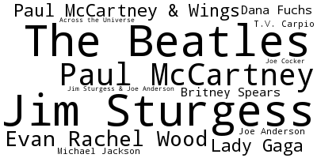
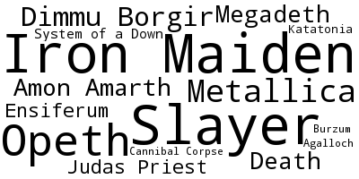
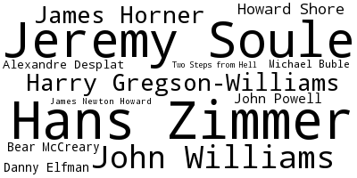
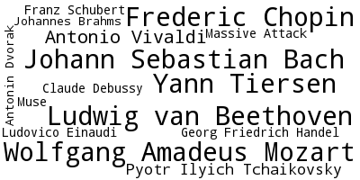
Sense Making: Music Streaming Data
Data crawled using Pop artists as seeds.
Natural bias towards Pop music
“Metal”
“Beatles”
“Classic”
“Soudtracks”
Notes:
Explain the dataset
Explain the figure slowly
Size
Steady state of the random walk
Visual cues towards to the environments

Slide 23
Qualitative Evaluation
(Amaral and Andrade 2016)
Andrade and Amaral 2016 (Unpublished, MsC Dissertation)
Interviewed 16 DJs from Northeast Brazil
Showed 5 Playlists with 5 songs to each
Attempts to generate Rhythm and Blues, Road Trip, Rock and Rock Pop playlists
Done by using the first song as seed
Focus on the feedback for the TribeFlow model.
I liked the groove on this song. It’s going to match well with the next one by Duran Duran: Hungry Like the Wolf.
It’s a rather conventional 70’s 80’s theme (…) However, who listens to the first song will likely like the others. It’s a good playlist in general.
Notes:
- In all honesty, ordering was an issue.

Slide 24
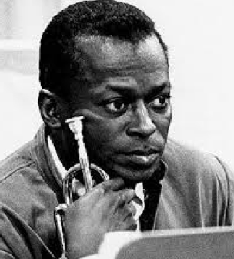
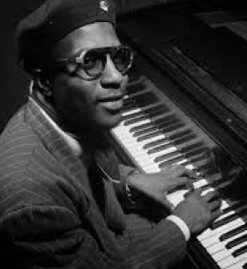
Other Datasets
(Andrade and Figueiredo, ISMIR 2016)
Musician Trajectories
Extracted from Discogs data
Focus on Jazz recordings
E.g., Sax players collaborating with leading Artists/Bands
Trajectory of a collaborator. For instance: 3 Steps in John Coltrane’s Trajectory
Notes:
- Davis, Monk, Davis

Slide 25
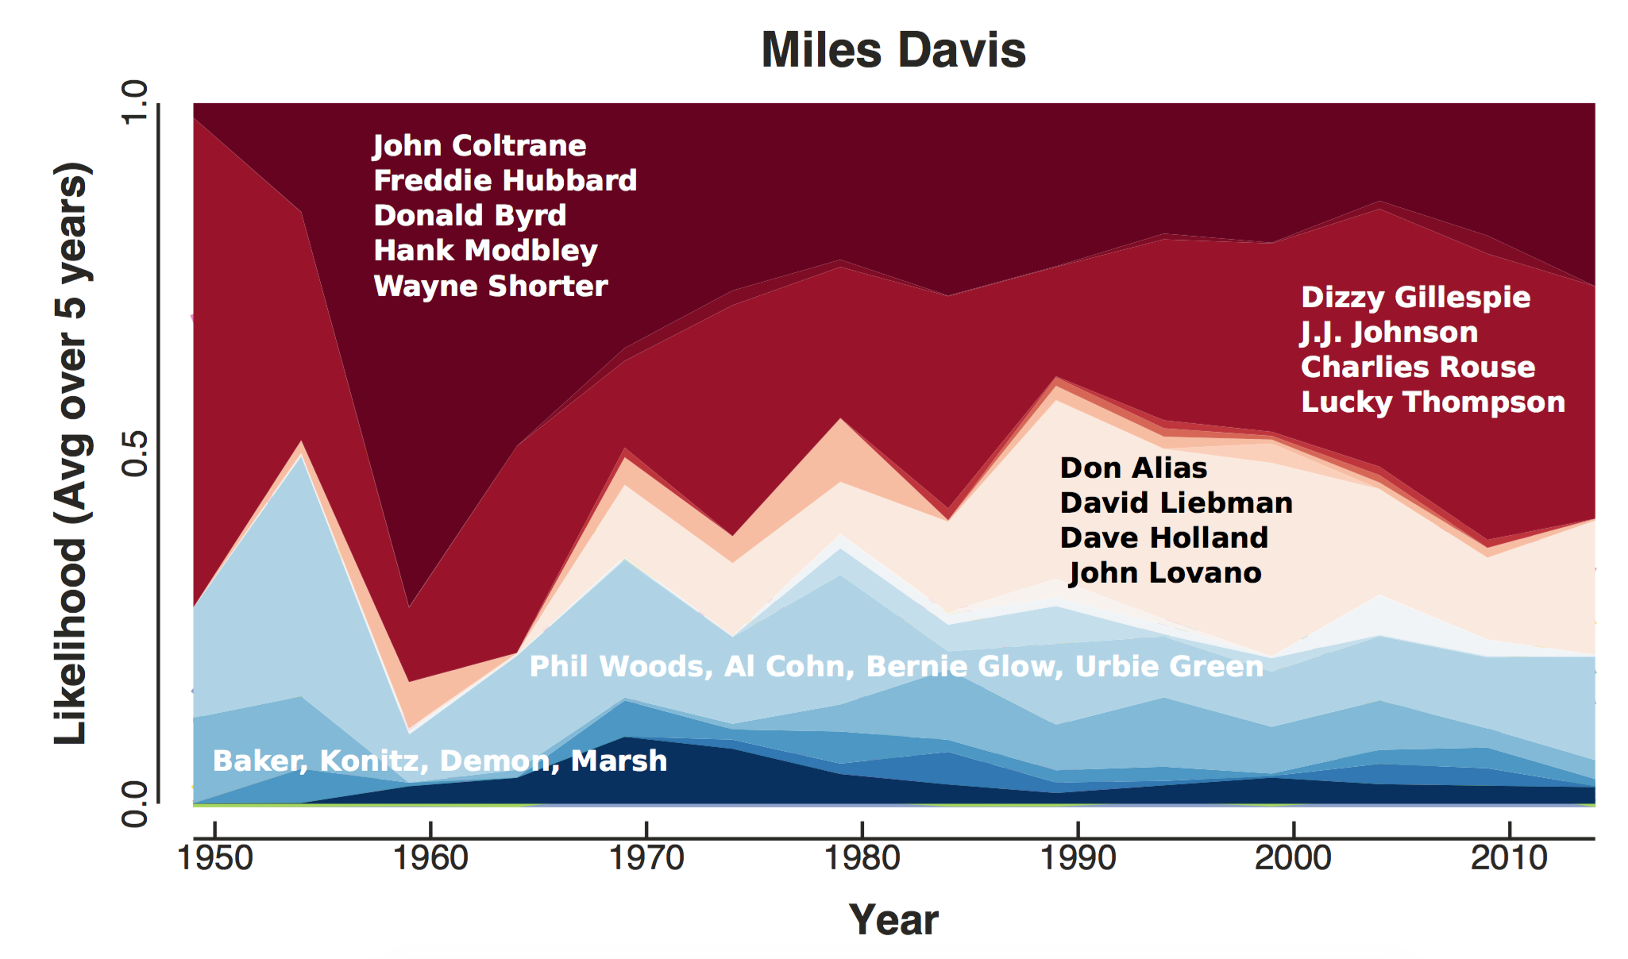
Other Datasets
(Andrade and Figueiredo, ISMIR 2016)
Notes:
- Find a place for this slide

Slide 26
Conclusions
TribeFlow
Predicts & mines user trajectories
Fast & scalable
Accurate & interpretable
Future Work
Supervised Learning
Other Domains
Combining with musical features
Thank You!
http://flaviovdf.github.io/tribeflow
Notes:
- Model, or matrices, or crownjewel

Slide 27
Backup slides

Slide 28

Navigational Constraints
Music Genre Constraints
Listening to Symphonic Heavy Metal after the Backstreet Boys Probably not
Listening to Symphonic Heavy Metal after Classical Music Possible
Application Constraints (e.g., Links on the Application)

Slide 29
TribeFlow’s Generative Model
Generative model variables:
Environments:
Transition Matrix
Simplify inference by breaking up sequence into renewal times of length B
Inter-event time survival distribution
Latent user preferences over environments
Notes:
- Tirar o “very nice”

Slide 30
Using Data Subsamples
20 cores
one node
Always faster & more accurate
Always faster and more
accurate

Slide 31
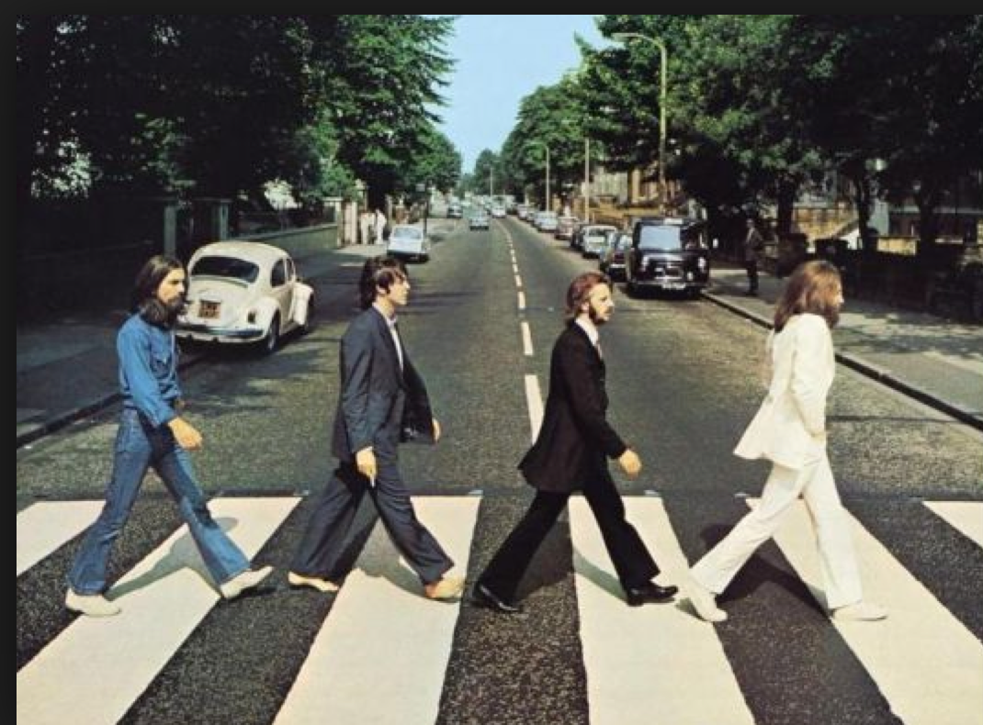
Users are not Synchronized
“Everybody” eventually goes through a “Beatles” phase

Slide 32
TribeFlow x Temporal Tensors
K x t
C
time
I x J x K
X
I x r
K x s
A
G
B
=
users
r x s x t
products
If users are not synchronized:
Notes:
- Simulated data

Slide 33
Variations of the Model
TribeFlow Without Inter Event Times Figueiredo et al. 2016 (WWW), Andrade and Figueiredo. 2016 (ISMIR)
TribeFlow Coupled with Modulated Markov Processes Figueiredo et al. 2016

